Slide 1
House price prediction using Multiple Linear Regression and Keras Neural Network model
Arindam Saha, 002011701091, Production Engineering
Under the guidance of Professor Dr. Debamalya Banerjee

Slide 2
Contents
Introduction
Multiple Linear Regression Model
Neural Network Model
Future Aspects
References

Slide 3
Advantages of House price prediction
By having accurate predictions of house prices, individuals and organizations can make more informed decisions when buying or selling properties. This can lead to better investment decisions and increased profitability.
Predictions of house prices can provide valuable insights into the real estate market, allowing individuals and organizations to better understand market trends and make more informed decisions.
Predictions of house prices can save time by eliminating the need to manually analyze market data, allowing individuals and organizations to focus on other important tasks.
Predictions of house prices can assist in forecasting future market trends, which can be used to make informed decisions about future investments.

Slide 4
Multiple Linear Regression

Slide 5
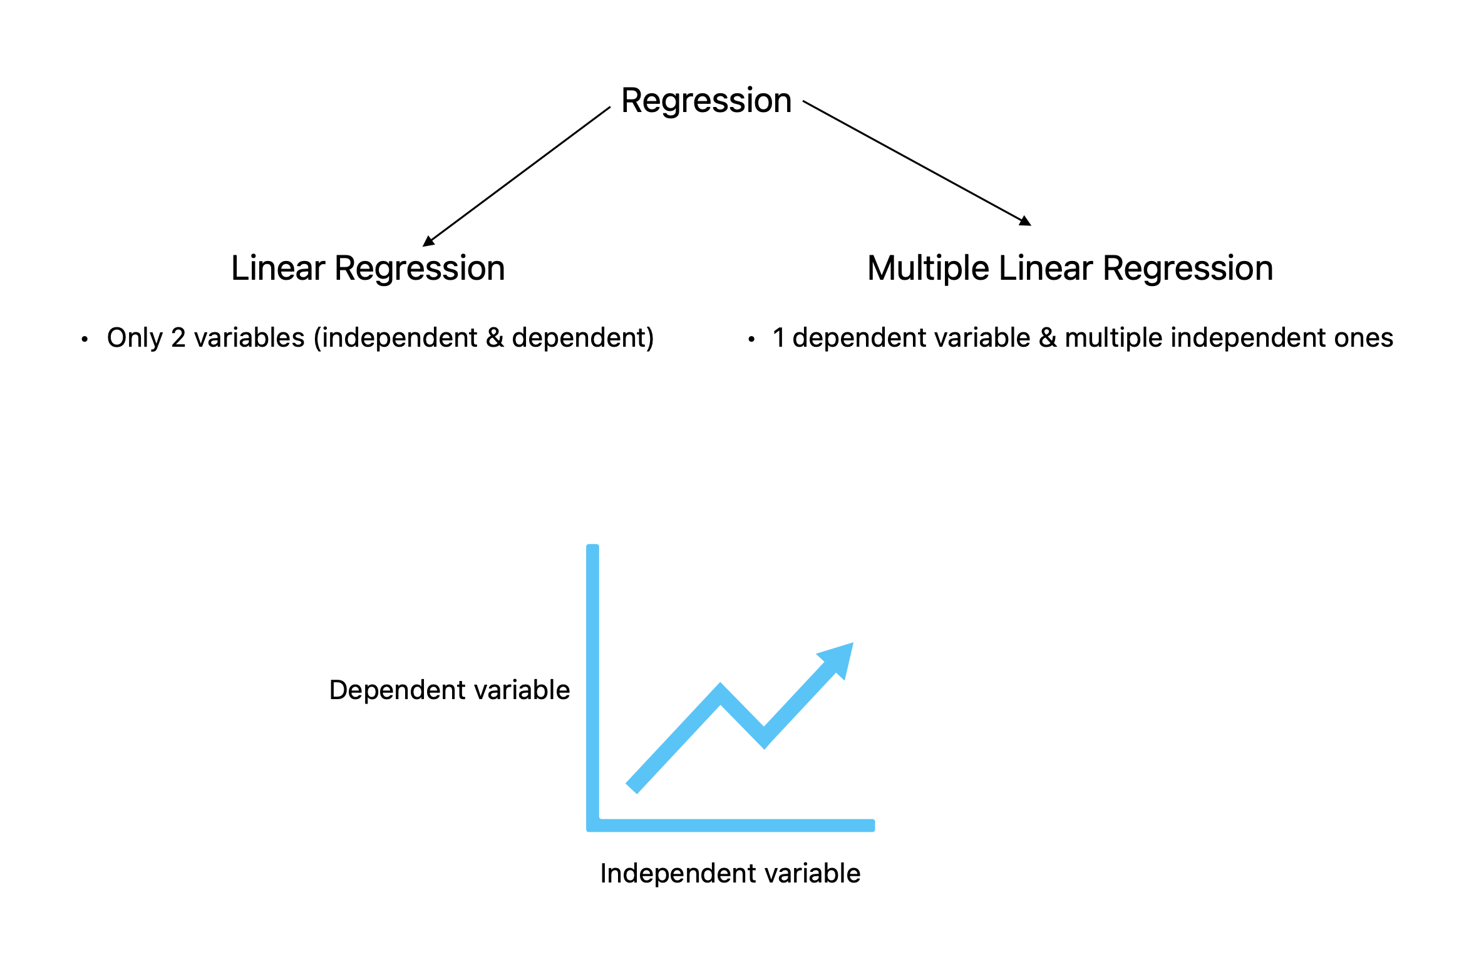
Regression is the quantitative measure of relationship between dependent and independent variables.

Slide 6
Multiple Linear Regression is given by the following eq:
y = b0 + b1x1 + b2x2 + ….. + bnxn - E
Assumptions
Linear relationship between two independent variables must be present
Independent variables must not be highly correlated to each other
y observations are selected randomly and independently from population
Residuals must be normally-distributed, with a mean of 0 and standard deviation of 1

Slide 7
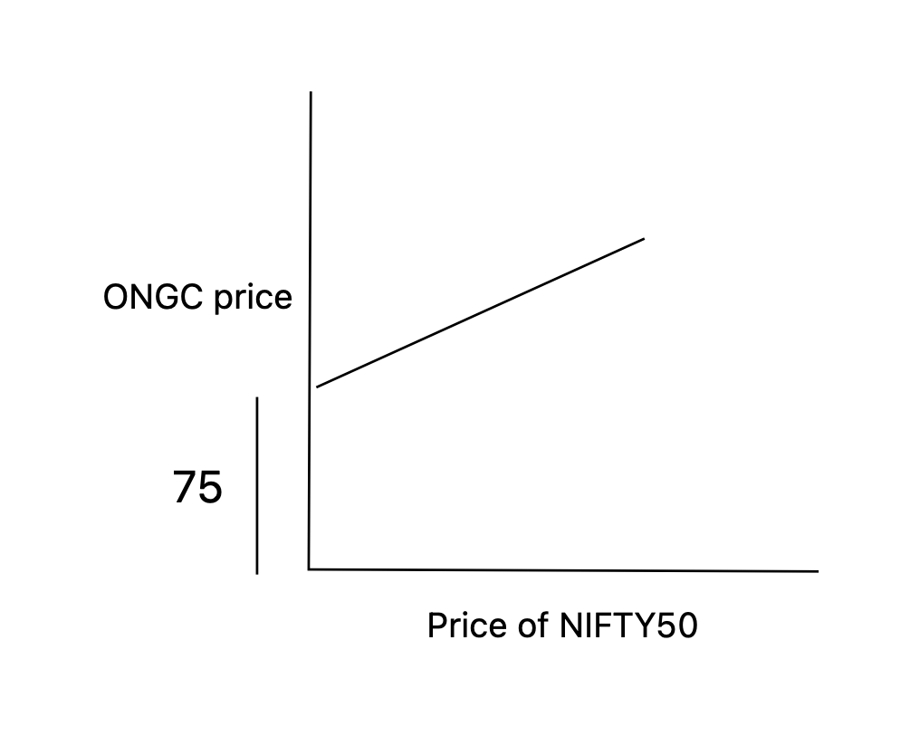
For example, suppose the price of ONGC share price. It depends on multiple
factors including the price of NIFTY50, price of oil, interest rate, price of future
derivatives, stock price of other oil companies etc.
Suppose the equation can be given by the following -
ONGC price = (75 - 1.5 * i + 7.8 * oil price + 3.2 * NIFTY50 + 5 * oil futures - E)
And R-sq = 83.4%

Slide 8
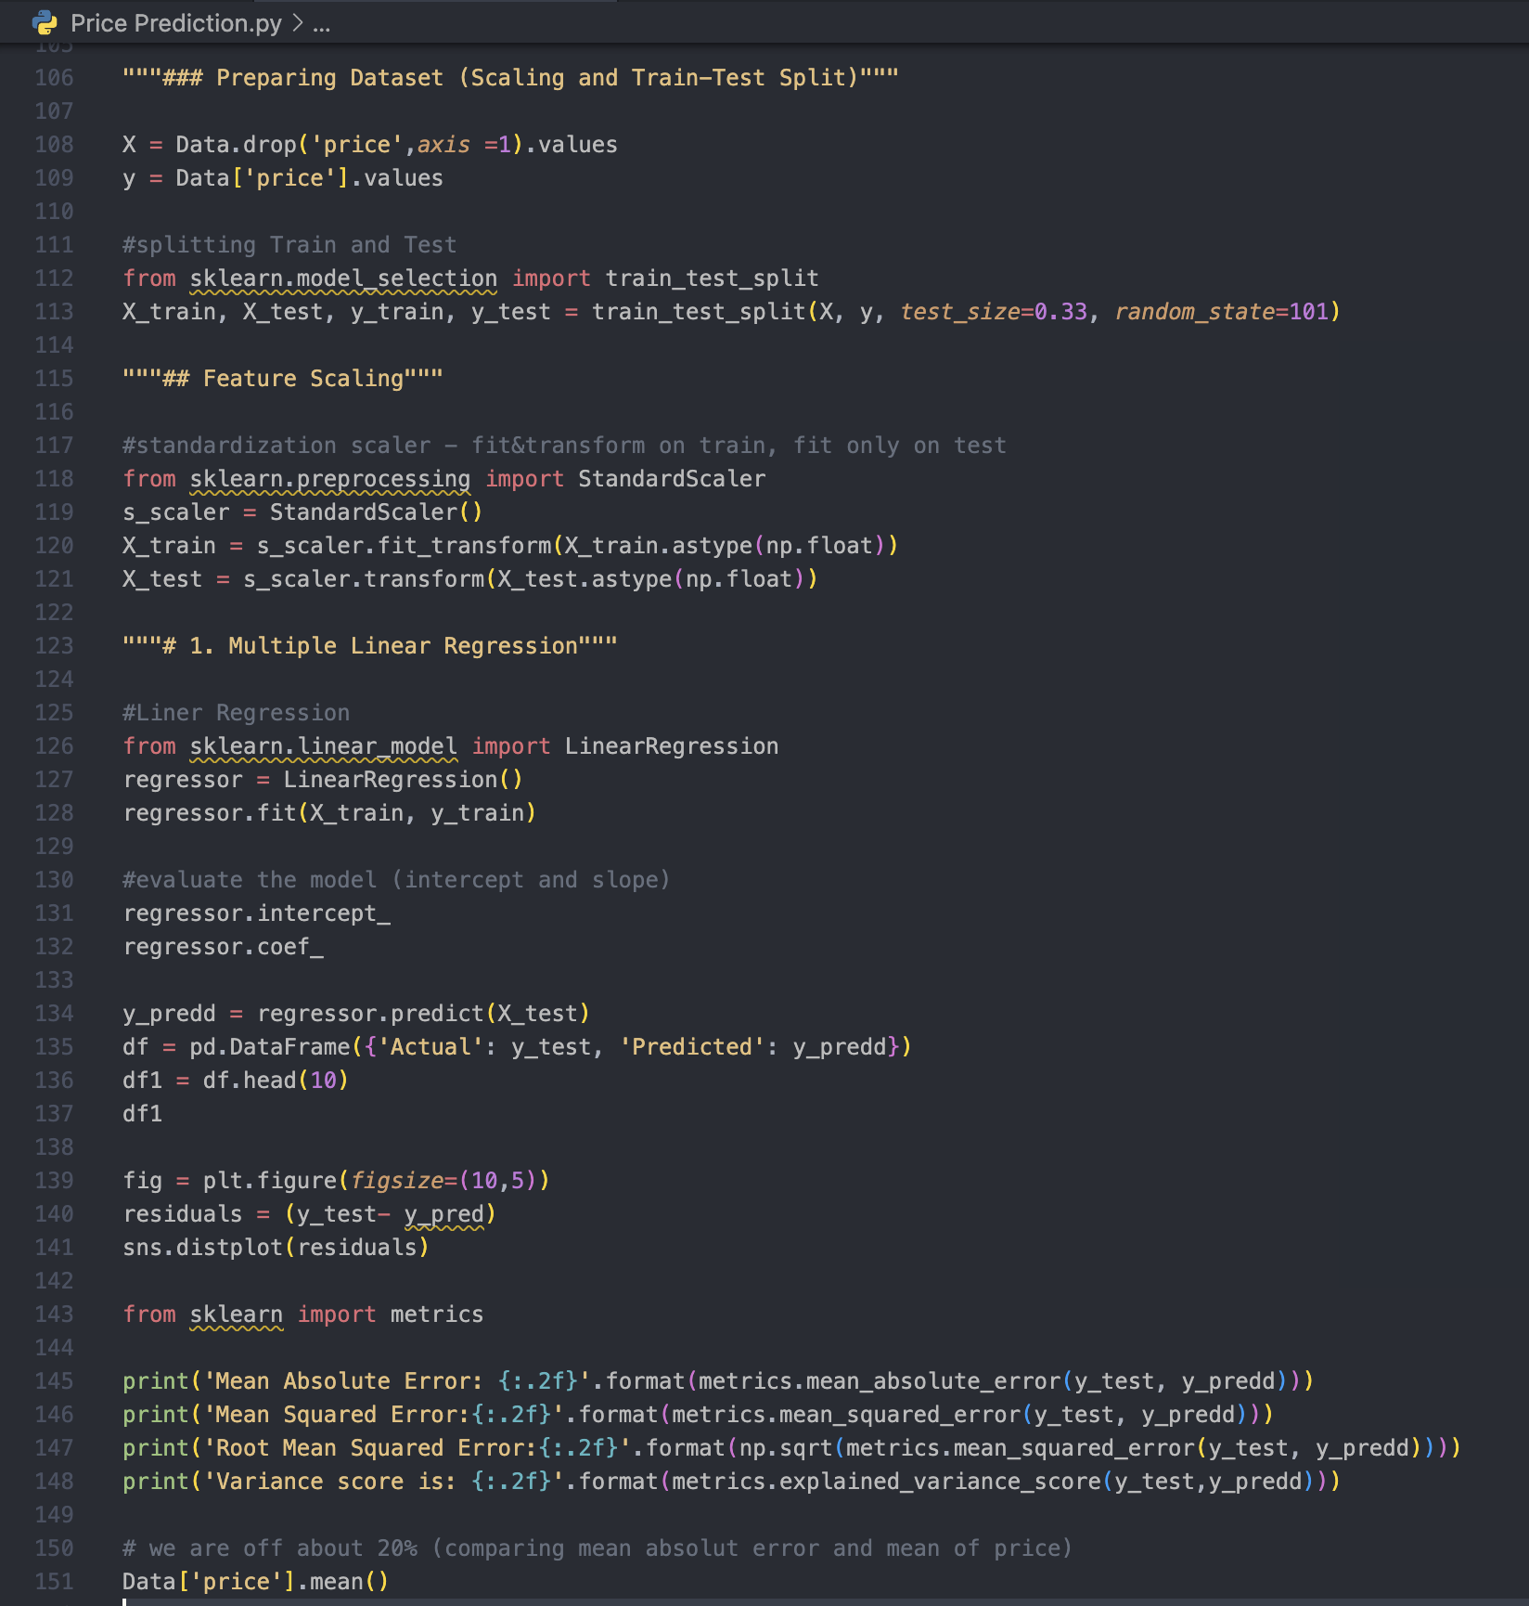
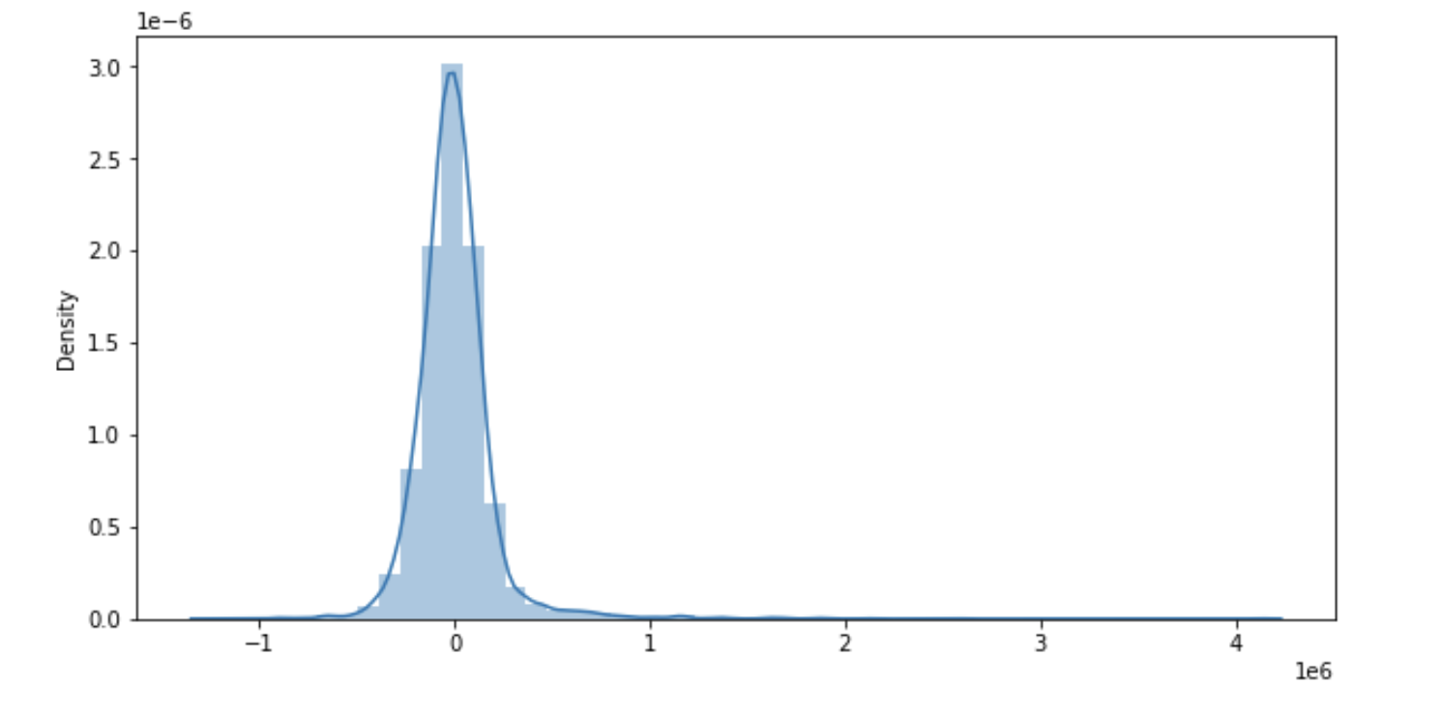
Implementation in Python
Get independent (x) and dependent variable (y) from dataset
Split train & test dataset
Feature Scaling
Do linear regression on x & y train splits
Find intercept & slope
Predict test result
Put result in a data frame
Check accuracy and errors
(y_test - y_pred)

Slide 9
Neural Network using Keras

Slide 10
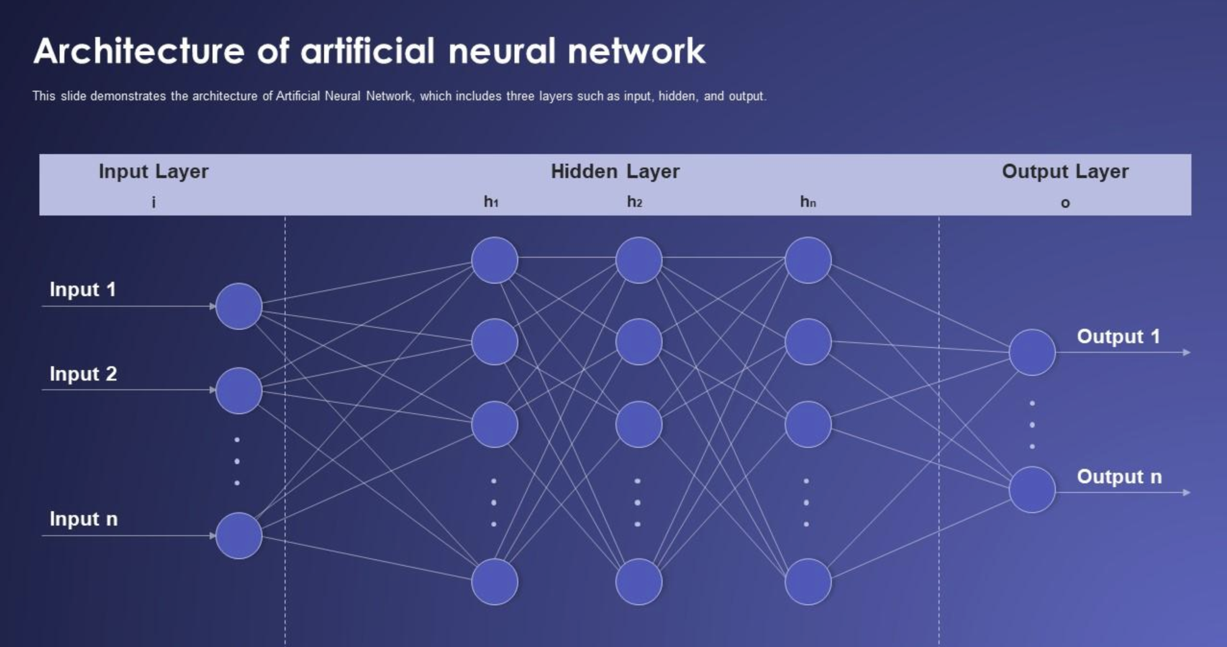

Slide 11
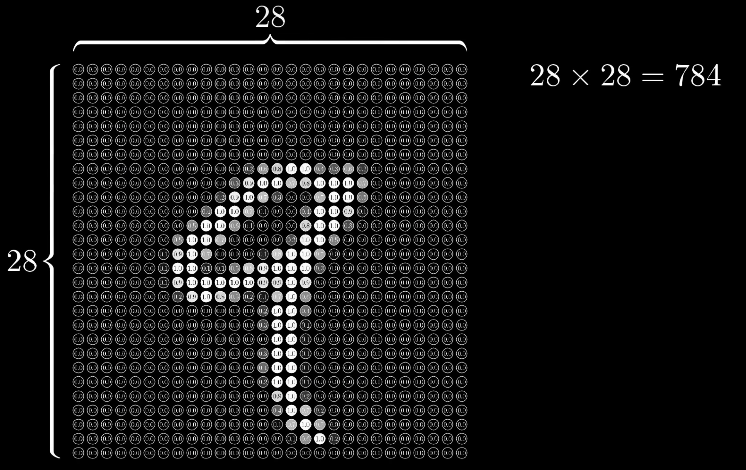
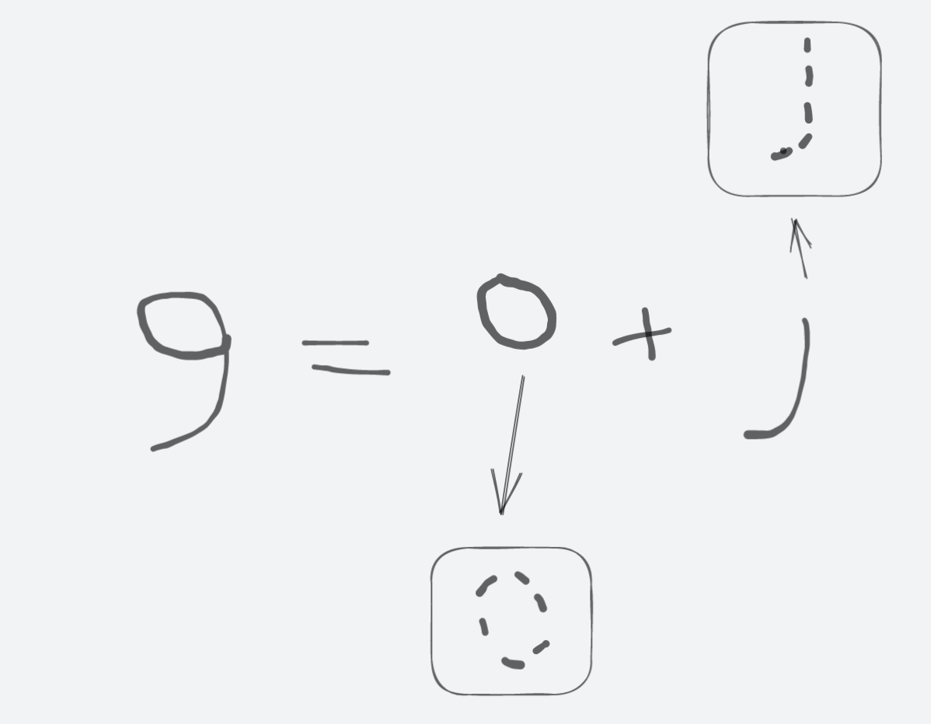
Neurones are mathematical function that collects & classifies information according to special architecture
Each Neurone is a perceptron, and is similar to
Multiple linear regression
Text Recognition System
Recognition
‘Re’ + ‘cog’ + ‘ni’ + ‘tion’

Slide 12
Types of Neural Networks
Feed-forward Neural Network
Recurrent Neural Network
Convolutional Neural Network
Deconvolutional Neural Network
Modular Neural Network

Slide 13
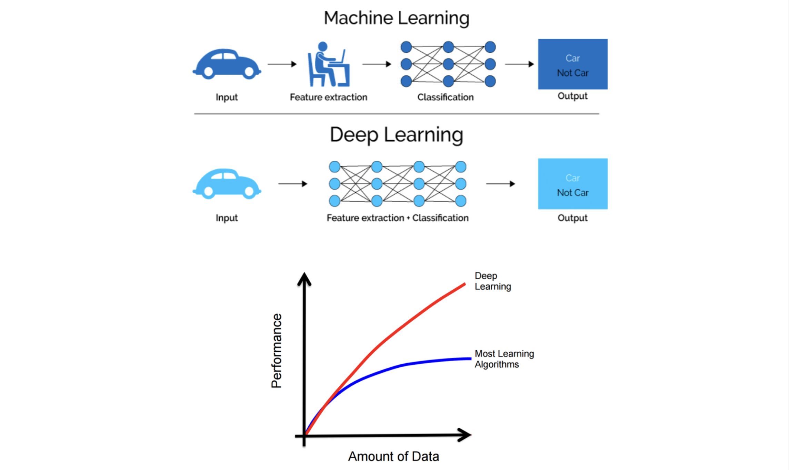
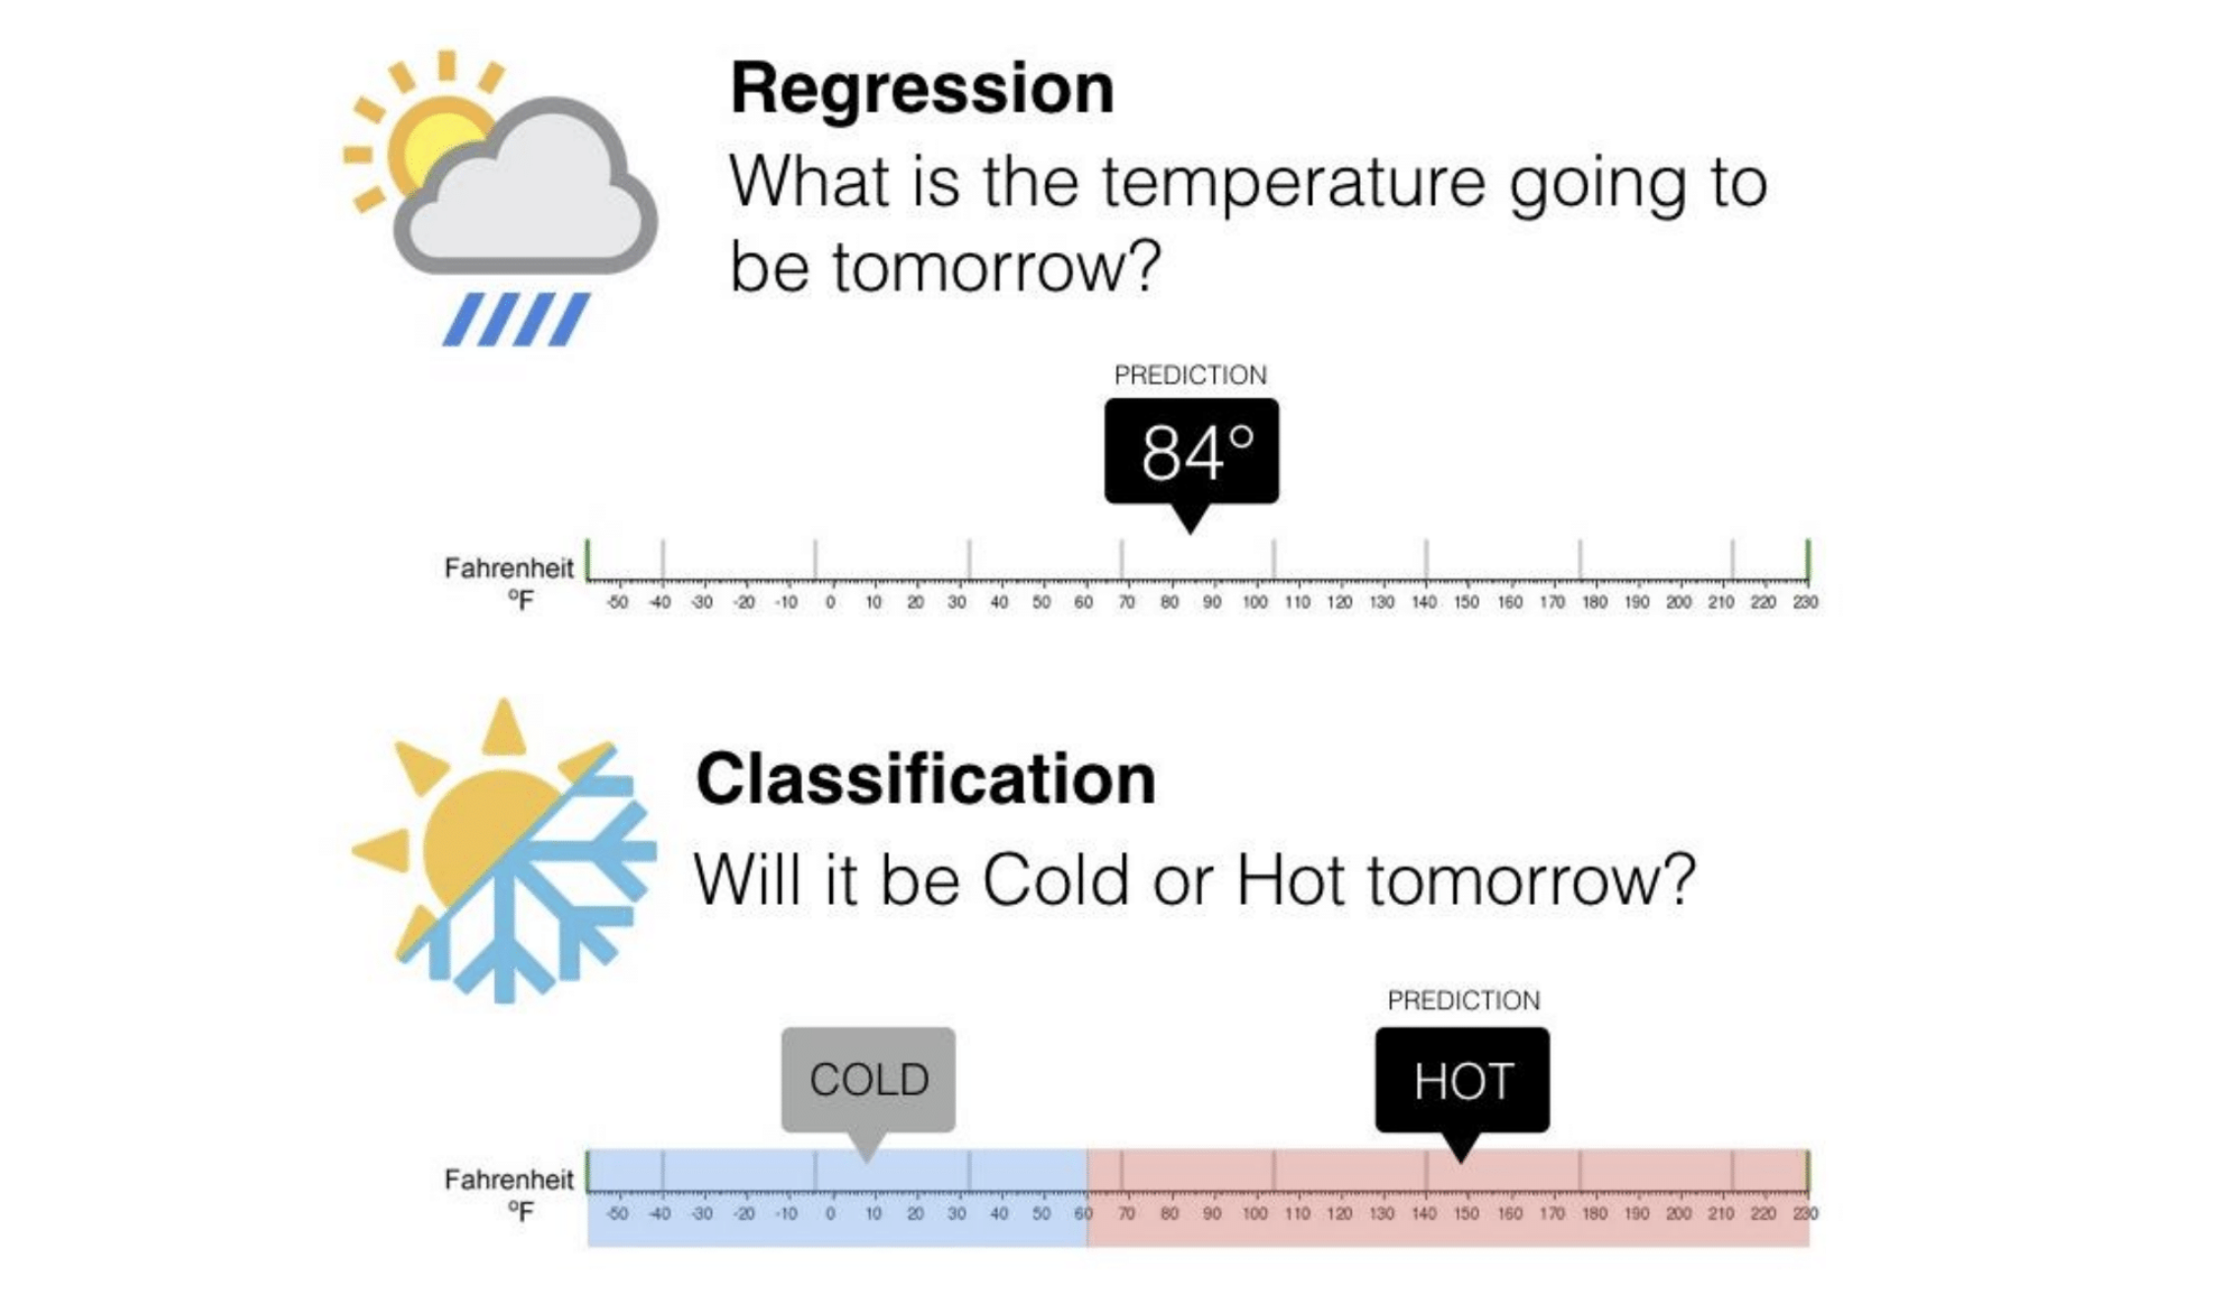
Deep Neural Network containing multiple layers, does its feature scaling itself.
There’s no need to extract features from raw data (like sentiments in a sentence)

Slide 14
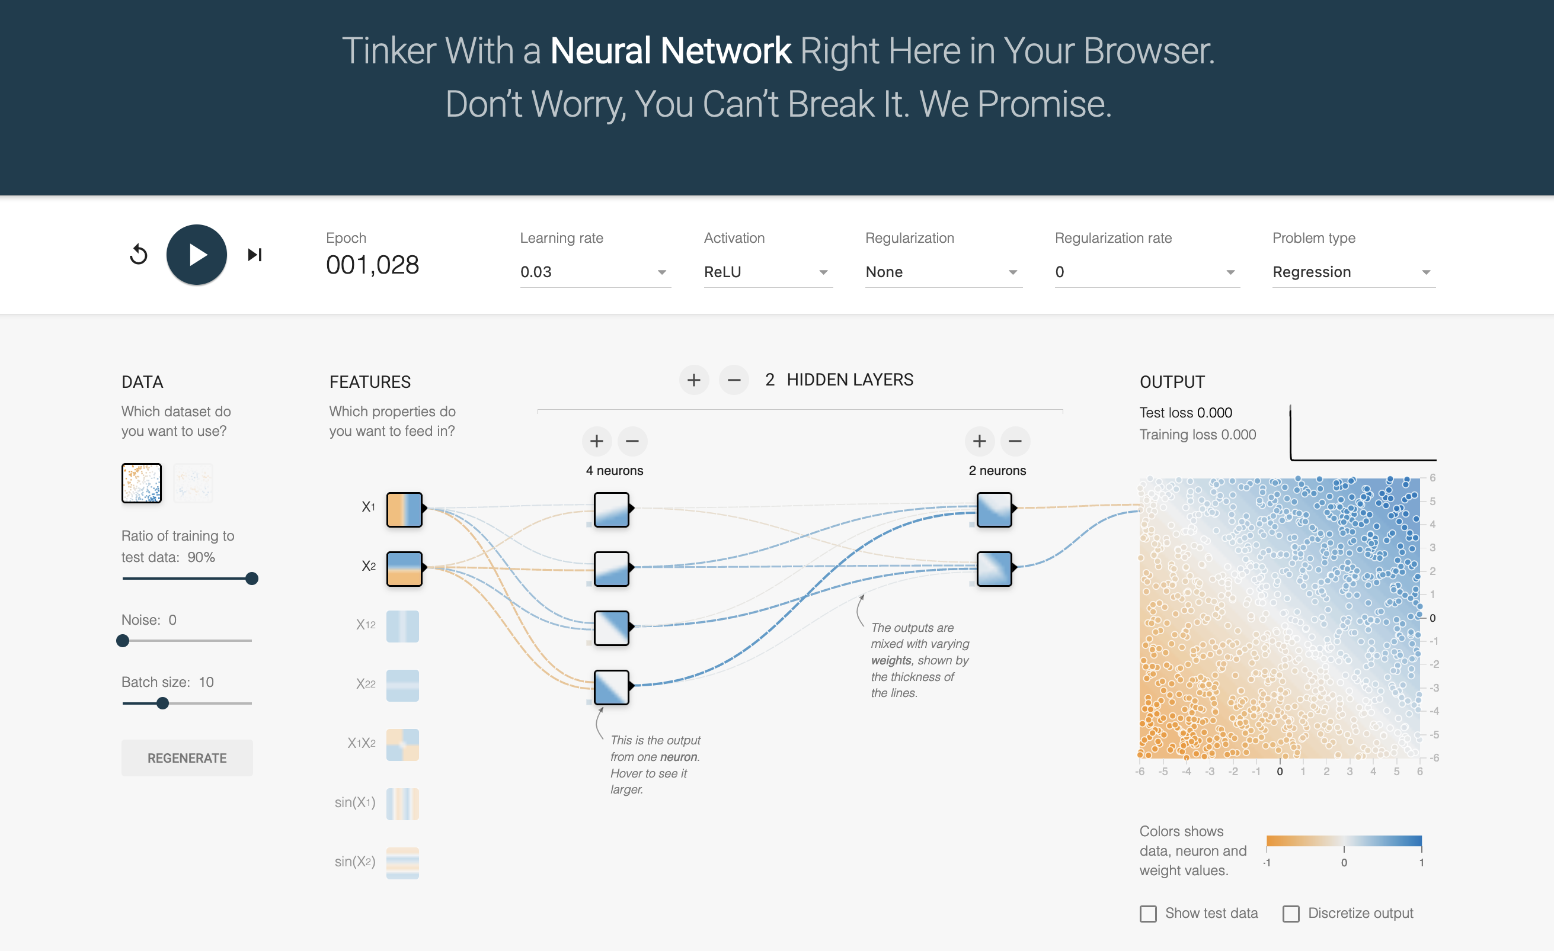
Playground[12]

Slide 15
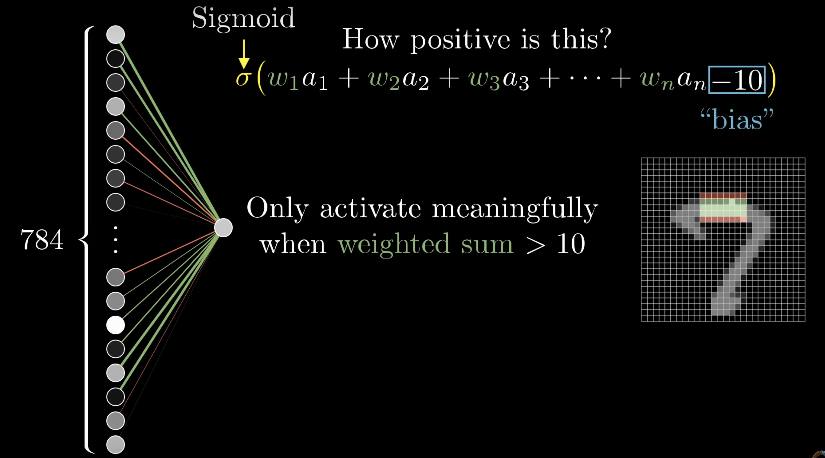

Slide 16
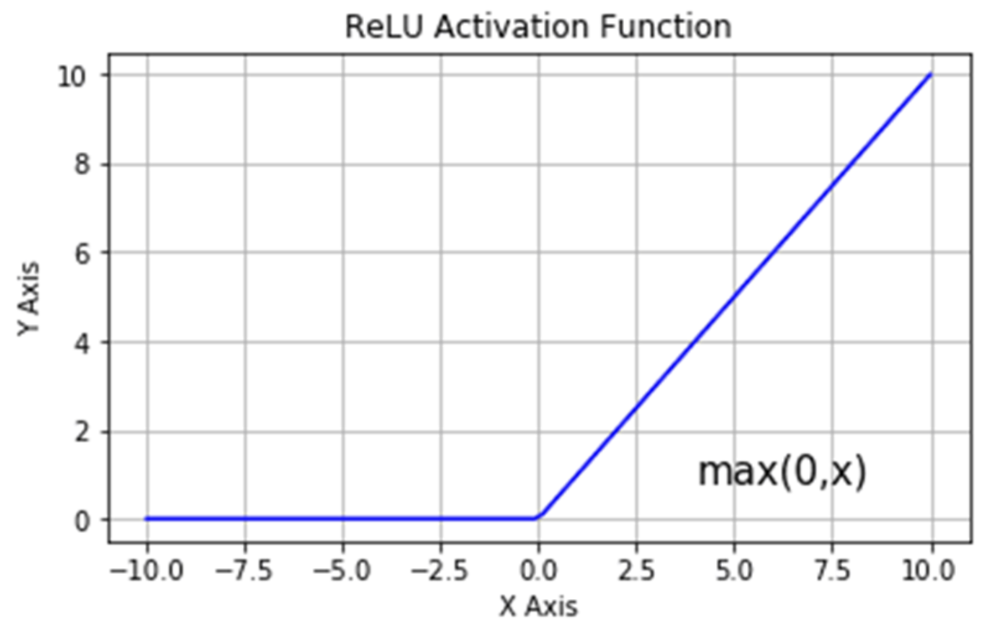
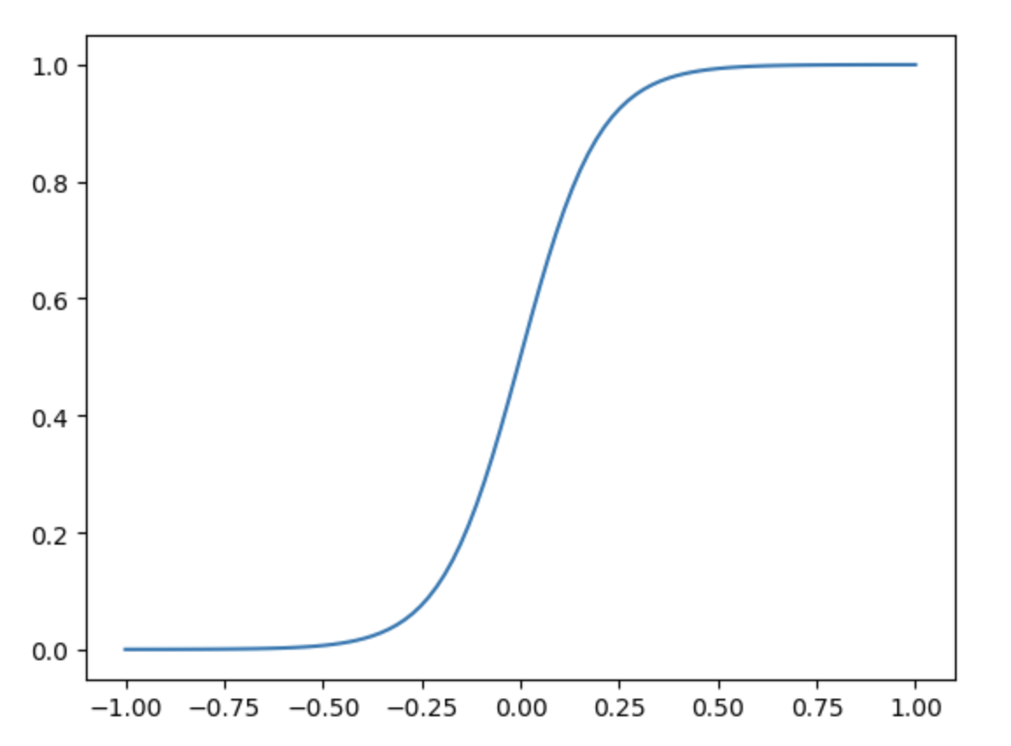
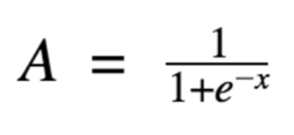
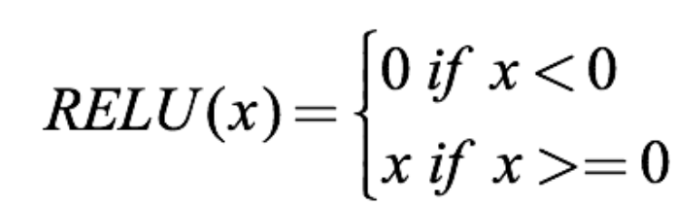
Activation Functions
Sigmoid Function
The purpose of the activation function is to introduce non-linearity into the output of the neuron, allowing the neural network to learn complex patterns and relationships in the input data.

Slide 17
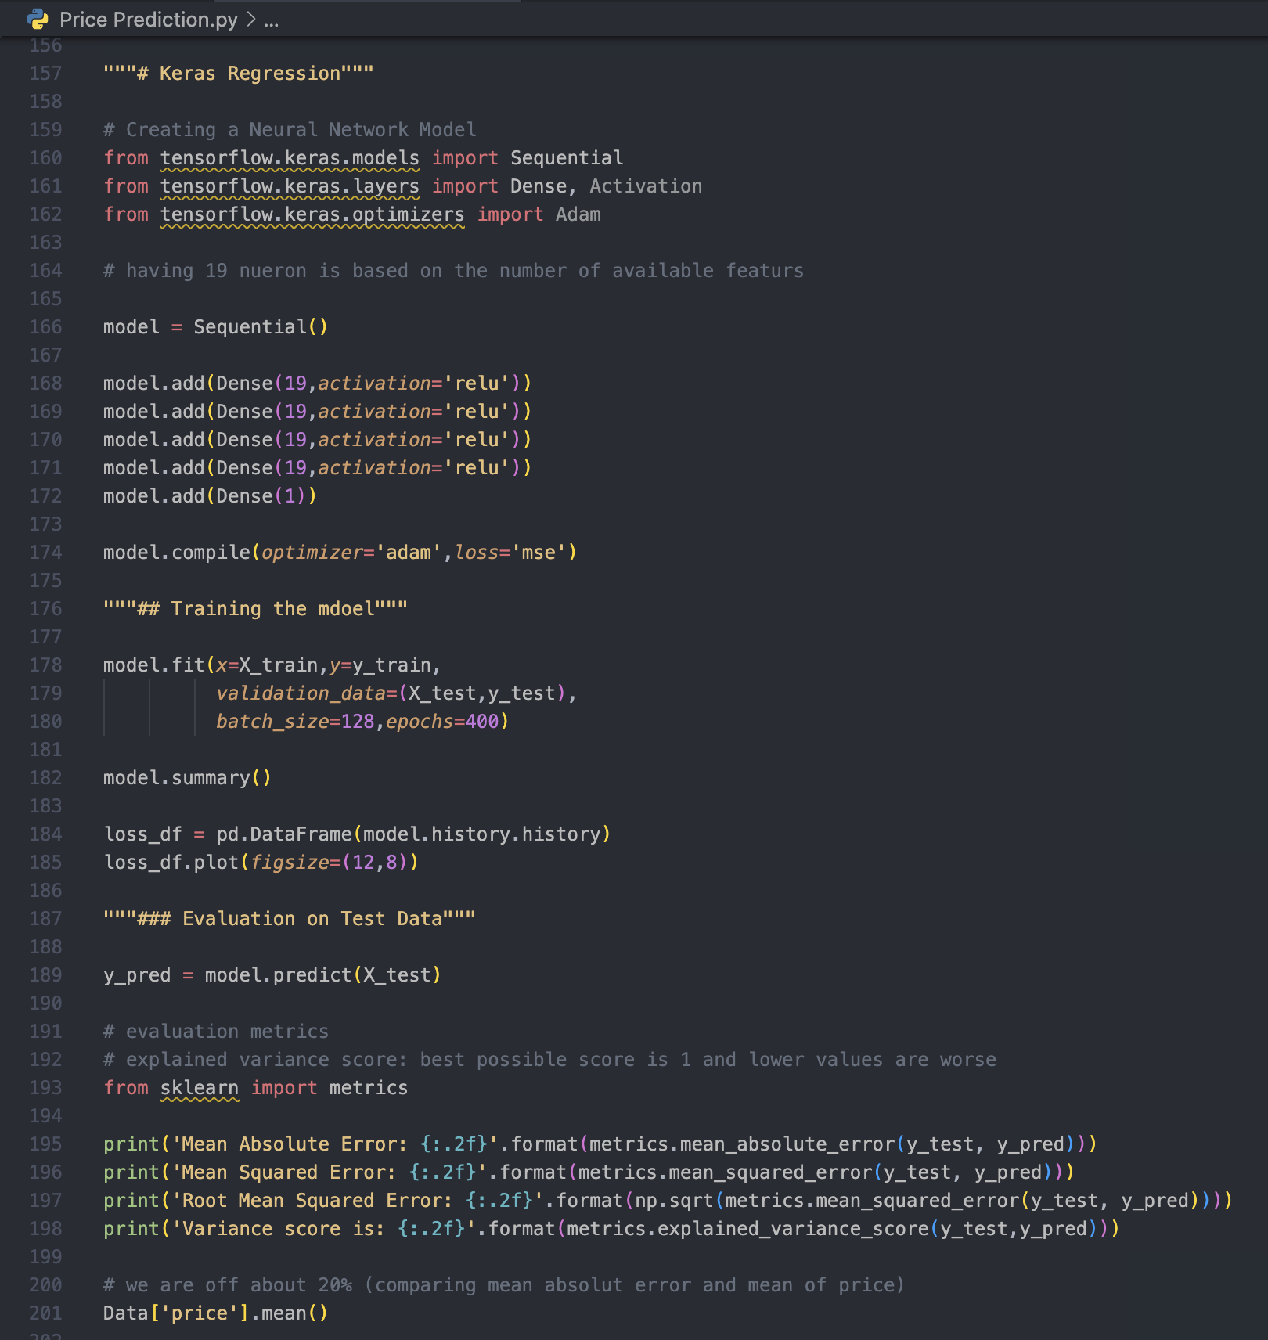
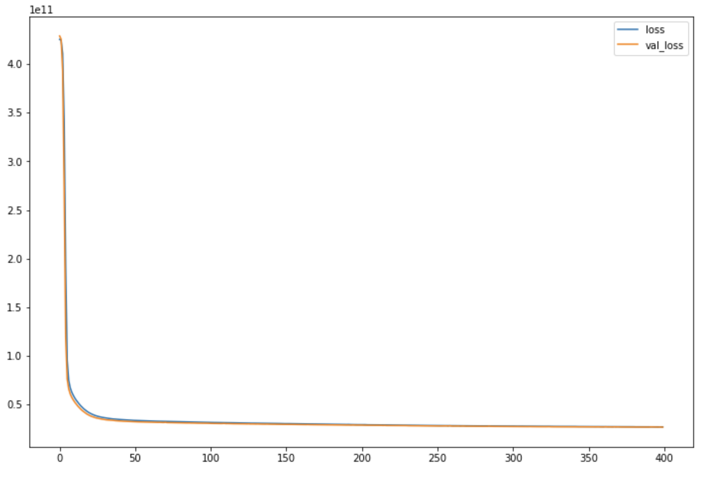
Implementation in Python
Import Sequential, Dense, Activation & Adam (Adaptive Moment Estimation)
Train the neural network
Use fit( ) method to feed the training data into the network (x_train, y_train)
Validate with the test datas (x_test, y_test)
Declare batch size & epochs
Plot the loss function with respect to training time
Generate predictions
Find accuracy & errors
The goal of training a neural network is to minimize the value of the loss function. This is done by adjusting the weights and biases of the network in a process called backpropagation.

Slide 18
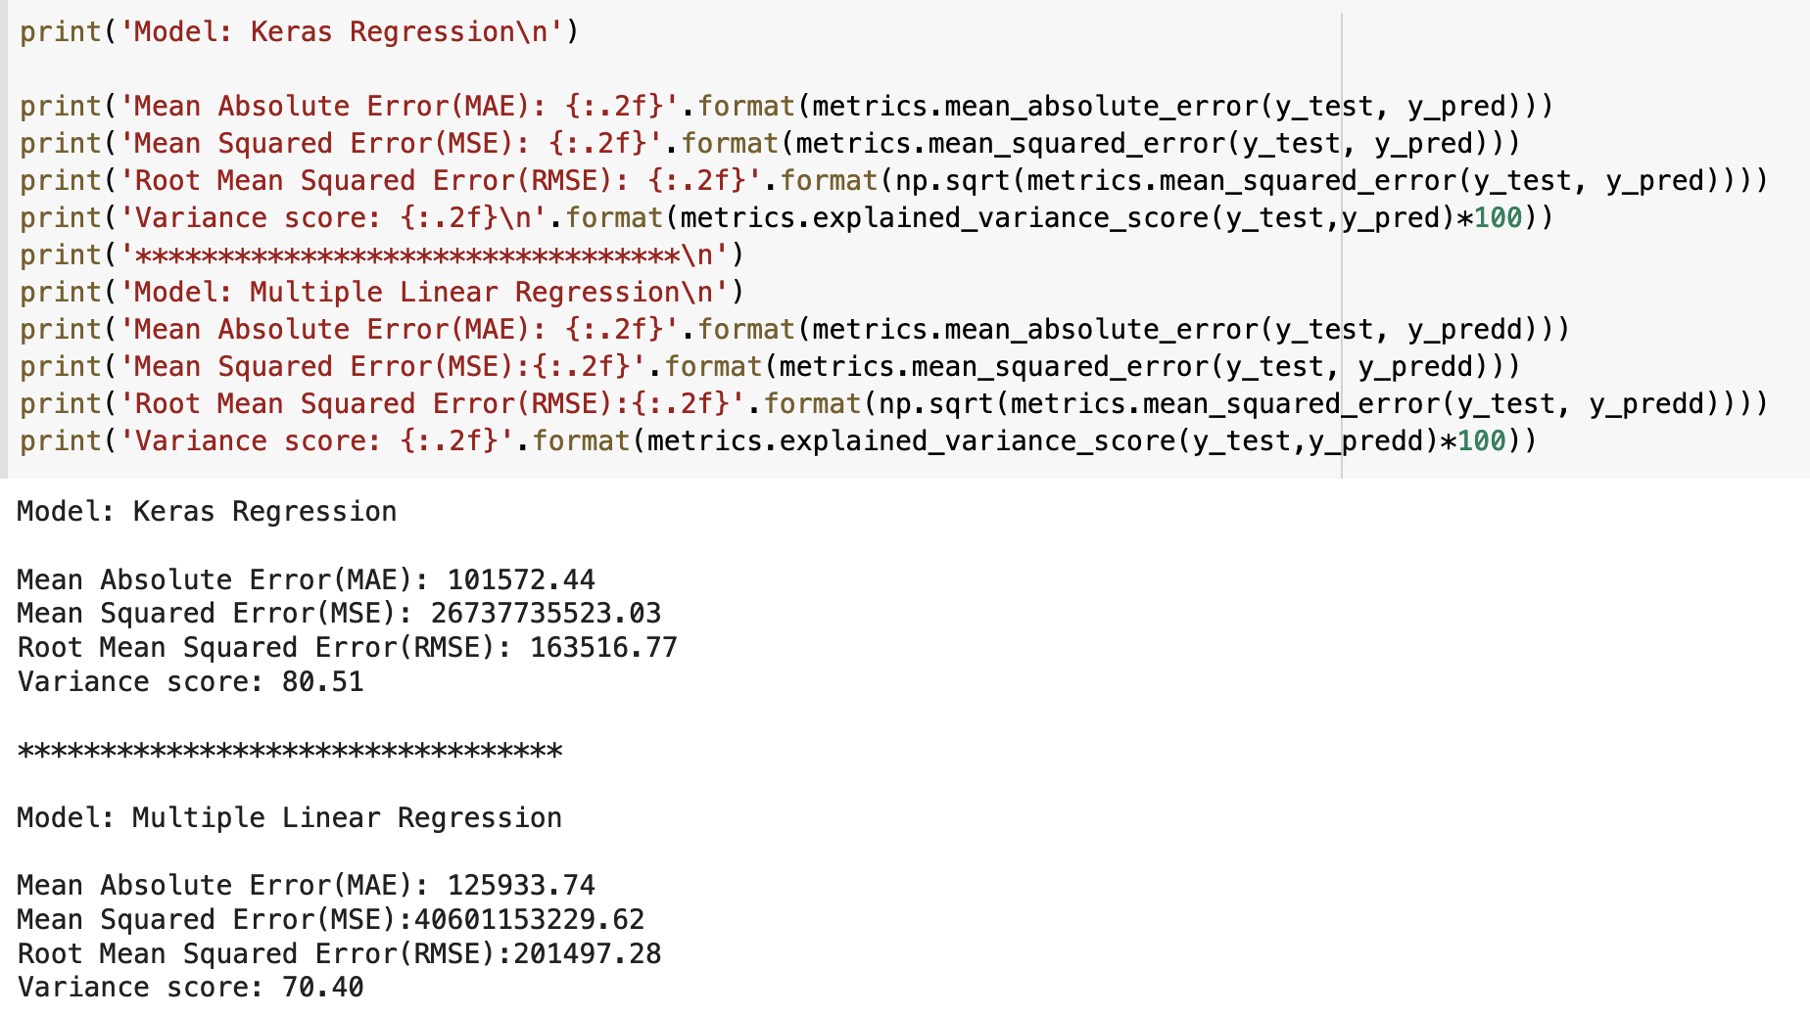
Accuracy
Multiple Regression Model (70.4%) Neural Network using Keras (80.51%)

Slide 19

Future Aspects
Incorporating additional data sources, such as economic indicators or news articles, to improve the accuracy of the predictions.
Experimenting with different neural network architectures, such as recurrent neural networks or transformers, to see if they perform better than the current architecture.
Developing an online or real-time version of the improved model.
Applying the model to different markets or assets, such as stocks, commodities, or currencies, to see if the model is applicable to other prediction tasks.

Slide 20
References
“Deep Learning Basics: Introduction and Overview”. MIT course 6.S094. Lex Fridman. https://youtu.be/O5xeyoRL95U
Quang Truong, Minh Nguyen, Hy Dang, Bo Mei, “Housing Price Prediction via Improved Machine Learning Techniques”, Procedia Computer Science, Volume 174, 2020, Pages 433-442, ISSN 1877-0509, https://doi.org/10.1016/j.procs.2020.06.111
Zulkifley, Nor & Rahman, Shuzlina & Nor Hasbiah, Ubaidullah & Ibrahim, Ismail. (2020). “House Price Prediction using a Machine Learning Model: A Survey of Literature”. International Journal of Modern Education and Computer Science. 12. 46-54, https://doi.org/10.5815/ijmecs.2020.06.04
Qingqi Zhang, "Housing Price Prediction Based on Multiple Linear Regression", Scientific Programming, vol. 2021, Article ID 7678931, 9 pages, 2021. https://doi.org/10.1155/2021/7678931
"Neural Regression using Keras”. https://visualstudiomagazine.com/articles/2018/07/23/neural-regression-using-keras.aspx
“Regression with Keras”. Pyimagesearch. https://pyimagesearch.com/2019/01/21/regression-with-keras/
7. “House Sales in King County, USA”. Kaggle. https://www.kaggle.com/datasets/harlfoxem/housesalesprediction
8. “Multiple Linear Regression Model, A Quick Guide”. Scribbr. https://www.scribbr.com/statistics/multiple-linear-regression/
9. “But what is a neural network? | Chapter 1, Deep learning”. 3Blue1Brown. https://youtu.be/aircAruvnKk
10. “Matplotlib References”. https://matplotlib.org/stable/api/index.html
11. “Seaborn: Statistical Data Visualisation”. https://seaborn.pydata.org/
12. “A Neural Network Playground”. Tensorflow. https://playground.tensorflow.org/

Slide 21
Thank You

